Slide 1
Introduction to digital transformation
Dr. Davood Wadi

Slide 2
Foundations of Digital Transformation

Slide 3
Agenda
Introduction to Digital Transformation
Digitization, Digitalization, and Digital Transformation
The Digital Transformation Pyramid

Slide 4
Digital Transformation
Digital transformation is the integration of digital technology into all areas of a business.
It fundamentally changes how businesses operate and deliver value to customers.
It requires a cultural shift that challenges the status quo.

Slide 5
Digital Transformation
Technology is a key enabler, but people and processes are equally important.
Data-driven decision-making is essential for successful transformation.

Slide 6
Key Components of Digital Transformation
Technology Integration: This involves the adoption of advanced technologies such as cloud computing, artificial intelligence (AI), big data analytics, the Internet of Things (IoT), and automation. These technologies enable organizations to streamline processes, enhance decision-making, and improve efficiency.

Slide 7
Key Components of Digital Transformation
Cultural Change: Digital transformation requires a shift in organizational culture. It encourages a mindset of innovation, agility, and collaboration. Employees at all levels must be willing to embrace change, experiment with new ideas, and adapt to evolving market conditions.

Slide 8
Key Components of Digital Transformation
Customer-Centric Approach: Understanding and meeting customer needs is at the heart of digital transformation. Organizations must leverage data and analytics to gain insights into customer behavior, preferences, and pain points, allowing them to deliver personalized experiences and build stronger relationships.

Slide 9
Key Components of Digital Transformation
Process Optimization: Digital transformation often involves reengineering business processes to eliminate inefficiencies and enhance productivity. This can include automating routine tasks, improving supply chain management, and optimizing resource allocation.

Slide 10
Key Components of Digital Transformation
Data-Driven Decision Making: Organizations must harness the power of data to inform their strategies and operations. By collecting, analyzing, and interpreting data, businesses can make informed decisions that drive growth and innovation.

Slide 11
Key Components of Digital Transformation
Agility and Flexibility: In a rapidly changing digital landscape, organizations must be agile and responsive. This means being able to quickly adapt to new technologies, market trends, and customer demands.

Slide 12
Discussion Question
Which company exemplifies Digital Transformation?

Slide 13
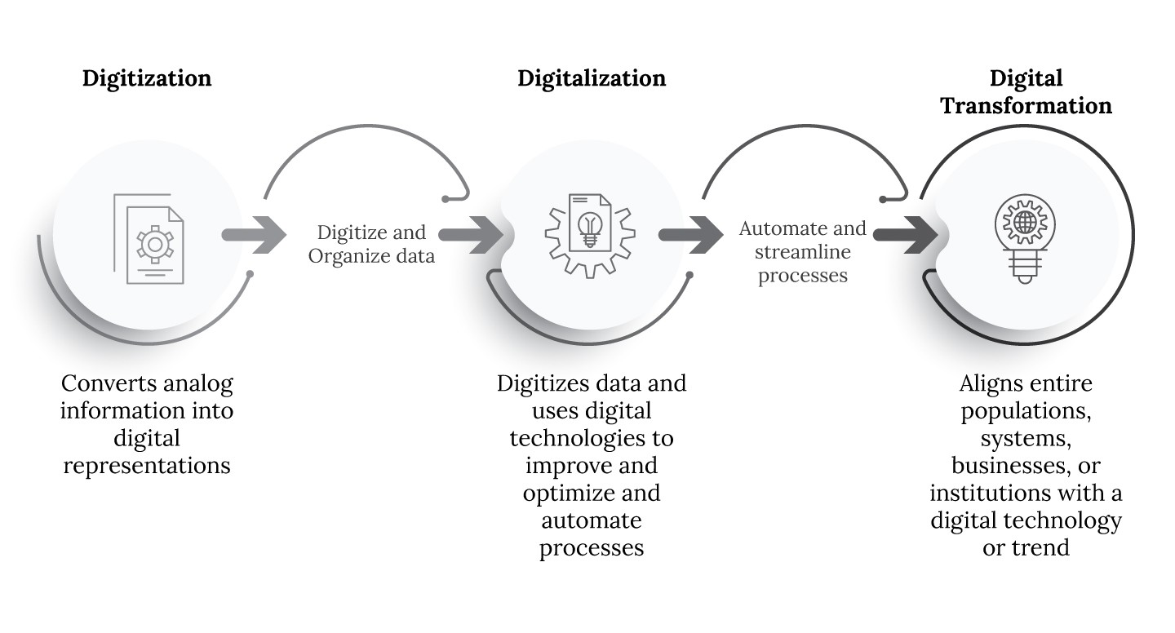
Digitization, Digitalization, and Digital Transformation

Slide 14
Digitization, Digitalization, and Digital Transformation
Digitization refers to converting analog information into digital format.
It involves the use of technology to improve efficiency and accuracy.
Digital transformation goes beyond digitization by rethinking business models and processes.

Slide 15
Digitization, Digitalization, and Digital Transformation
It focuses on enhancing customer experiences and creating new value propositions.
Successful digital transformation requires a strategic vision and leadership commitment.

Slide 16
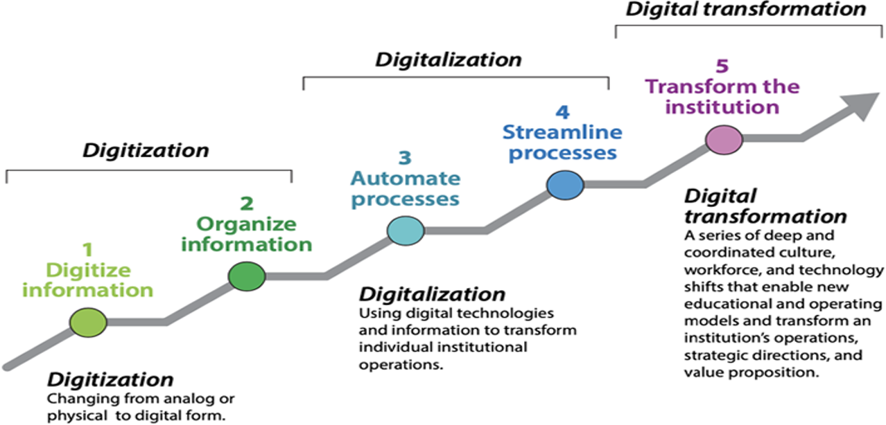
Digitization, Digitalization, and Digital Transformation

Slide 17
Discussion Question
How can organizations ensure that their digitization efforts align with their overall digital transformation strategy?

Slide 18
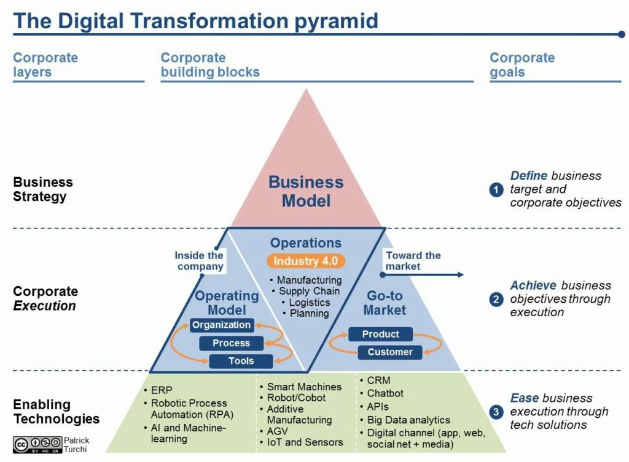
The Digital Transformation Pyramid

Slide 19
The Digital Transformation Pyramid
1. Foundation Layer (Technology Infrastructure)
Description: This is the base of the pyramid and includes the essential technology infrastructure that supports digital initiatives. It encompasses hardware, software, networks, and data management systems.
Key Components: Cloud computing, data storage solutions, cybersecurity measures, and network infrastructure.

Slide 20
The Digital Transformation Pyramid
2. Data Layer
Description: Above the foundation, this layer focuses on data collection, management, and analytics. Organizations need to harness data effectively to drive insights and decision-making.
Key Components: Data governance, data analytics tools, business intelligence, and data visualization.

Slide 21
The Digital Transformation Pyramid
3. Process Layer
Description: This layer involves the re-engineering of business processes to leverage digital technologies. It emphasizes automation, efficiency, and agility in operations.
Key Components: Workflow automation, process optimization, and integration of digital tools into existing processes.

Slide 22
The Digital Transformation Pyramid
4. Customer Experience Layer
Description: This layer focuses on enhancing the customer experience through digital channels. It involves understanding customer needs and preferences and delivering personalized experiences.
Key Components: Customer relationship management (CRM) systems, digital marketing strategies, and user experience (UX) design.

Slide 23
The Digital Transformation Pyramid
5. Culture and Leadership Layer
Description: At the top of the pyramid, this layer emphasizes the importance of organizational culture and leadership in driving digital transformation. A supportive culture and visionary leadership are crucial for successful implementation.
Key Components: Change management, employee training and development, and fostering a culture of innovation and collaboration.

Slide 24
The Digital Transformation Pyramid
6. Innovation Layer (Optional)
Description: Some models include an additional layer focused on innovation, which encourages organizations to continuously explore new technologies and business models.
Key Components: Research and development (R&D), experimentation, and partnerships with startups or tech companies.

Slide 25
Summary
Introduction to Digital Transformation
Digitization, Digitalization, and Digital Transformation
The Digital Transformation Pyramid

Slide 26
Questions?

